Slide 1

Signal interactions
Cross correlation, cross spectral coupling and significance testing
Centre for Doctoral Training in Healthcare Innovation
Dr. Gari D. Clifford,
University Lecturer & Associate Director,
Centre for Doctoral Training in Healthcare Innovation,
Institute of Biomedical Engineering,
University of Oxford

Slide 2

Cross correlation
  Time domain
Cross spectral coupling
  Fourier
  Wavelet
Detecting significance in the time domain
  Parametric
  Non-parametric
Detecting significance in the frequency domain
  Parametric
  Non-parametric

Slide 3



A time domain statistic
A measure of similarity of two time series as a function of a time-lag applied to one of them
Also known as cross-covariance, a sliding dot product or inner-product.
Commonly used to search a long duration signal for a shorter, known feature.
(* indicates complex conjugate)
The cross-correlation is similar in nature to the convolution of two functions. Whereas convolution involves reversing a signal, then shifting it and multiplying by another signal, correlation only involves shifting it and multiplying (no reversing).
Notes:
c = xcorr(x,y,coef');

Slide 4
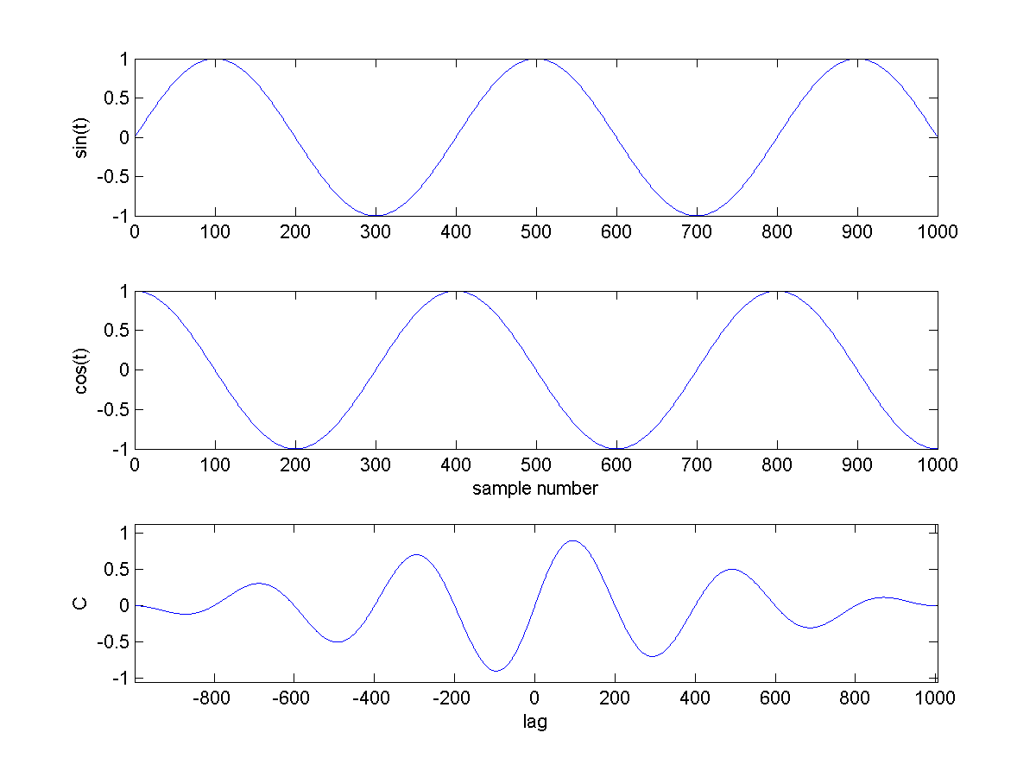
Similar in nature to the convolution of two functions.
  Convolution involves reversing a signal, then shifting it and multiplying by another signal
  Correlation only involves shifting it and multiplying (no reversing)
What’s the correlation function between sine & cosine?
Notes:
c = xcorr(x,y,coef');
f=0.2;t=[1:1000]/200; x=sin(2*pi*f*t); y=cos(2*pi*f*t);
[c lags] = xcorr(x,y,'coeff');
subplot(3,1,3);plot(lags,c); xlabel('lag'); ylabel('C');
subplot(3,1,2);plot(y); ylabel('cos(t)'); xlabel('sample number')
subplot(3,1,1);plot(x); xlabel('sin(t)');

Slide 5
Cross correlation function
Cos & Sin are the same, but π/2 out of phase
So C has max/min (=±1) at ±π/2 (± 100 samples)
Completely (anti-) correlated at this point
Another max every 200 sample shift (with alternating sign)
Function dies away at edges (less samples)
Completely symmetric
Theoretically equal to correlation coefficient r=max(C )
f=0.5;t=[1:1000]/200; x=sin(2*pi*f*t); y=cos(2*pi*f*t); [c lags] = xcorr(x,y,'coeff');
Notes:
c = xcorr(x,y,coef');
f=0.2;t=[1:1000]/200; x=sin(2*pi*f*t); y=cos(2*pi*f*t);
[c lags] = xcorr(x,y,'coeff');
subplot(3,1,3);plot(lags,c); xlabel('lag'); ylabel('C');
subplot(3,1,2);plot(y); ylabel('cos(t)'); xlabel('sample number')
subplot(3,1,1);plot(x); xlabel('sin(t)');

Slide 6

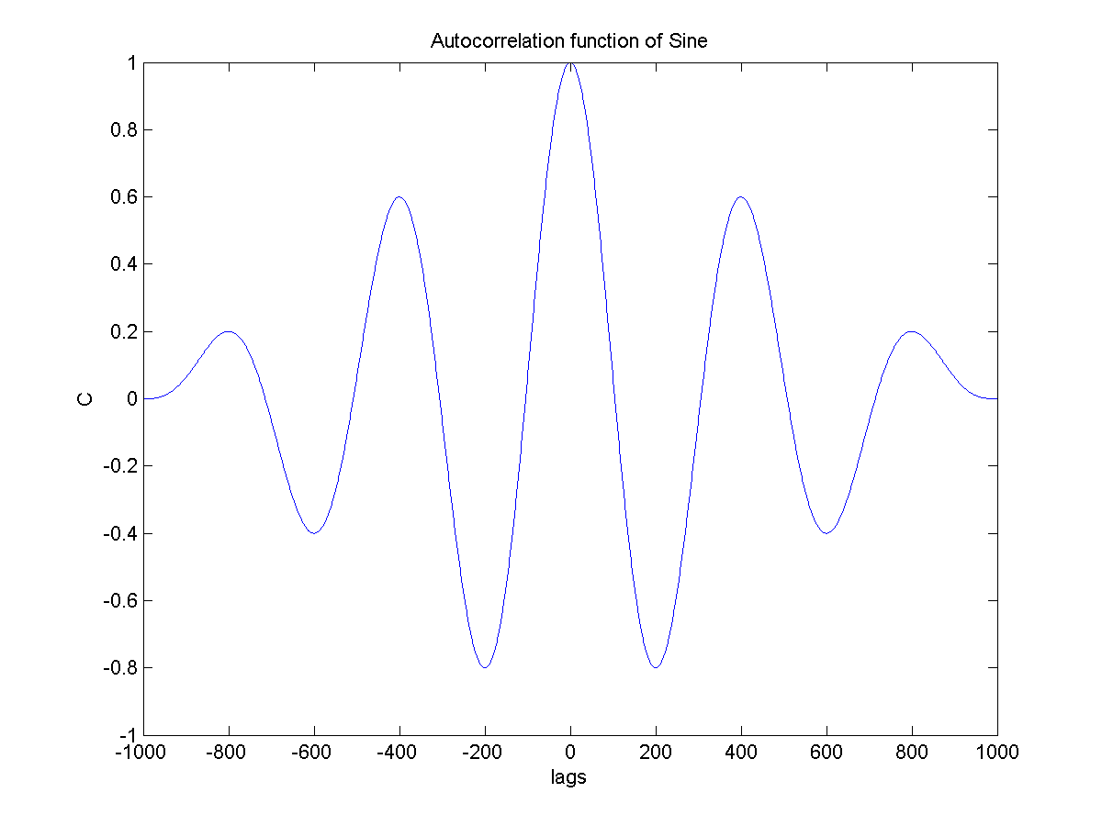
Cross correlation of sine with itself

Slide 7

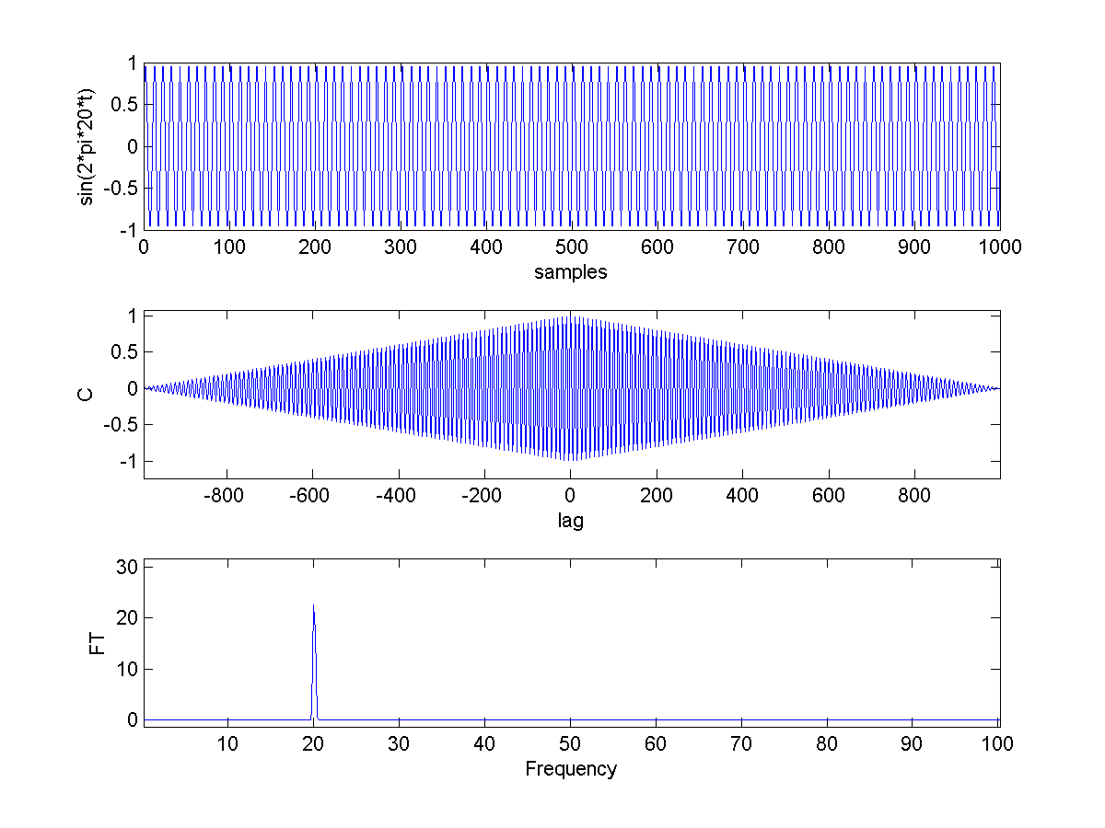
FT(C) is the PSD!
(Wiener–Khinchin theorem, Wiener–Khintchine theorem, Wiener–Khinchin–Einstein theorem or the Khinchin–Kolmogorov theorem)
Notes:
The Wiener–Khinchin theorem (also known as the Wiener–Khintchine theorem and sometimes as the Wiener–Khinchin–Einstein theorem or the Khinchin–Kolmogorov theorem) states that the power spectral density of a wide-sense-stationary random process is the Fourier transform of the corresponding autocorrelation function

Slide 8

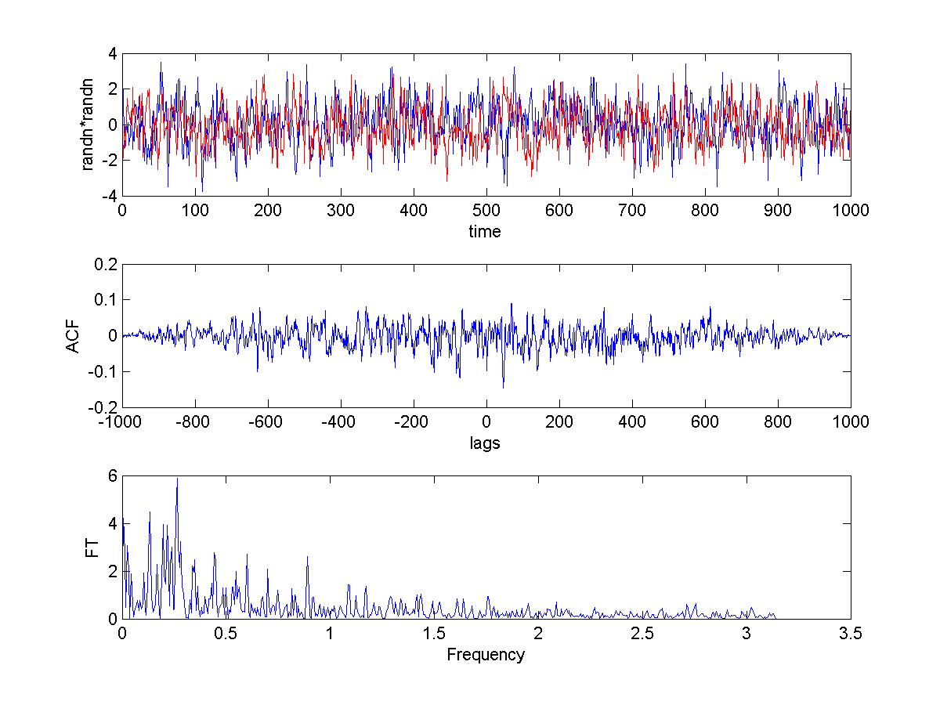
Take two random time series
  y(1)=randn(1,1);for(i=2:1000); y(i)=y(i-1)/2+randn(1,1);end
  x(1)=randn(1,1);for(i=2:1000); x(i)=x(i-1)/2+randn(1,1);end
A correlation >0 doesn’t mean there is really any ‘significant’ correlation
But - size of correlation doesn’t imply anything regarding significance
Notes:
y(1)=randn(1,1);for(i=2:1000); y(i)=y(i-1)/2+randn(1,1);end
x(1)=randn(1,1);for(i=2:1000); x(i)=x(i-1)/2+randn(1,1);end
[c lags] = xcorr(x,y,'coeff');
[Pxx,F] = pwelch(x-mean(x),hamming(1000),500);
subplot(3,1,3);plot(F,Pxx)
subplot(3,1,2);plot(lags,c); xlabel('lag'); ylabel('C');
subplot(3,1,1);plot(x);
subplot(3,1,1);hold on;plot(y,'r');

Slide 9

Parametric:
  Bartlett’s (1935) correction
  (Orcutt & James, Biometrika (1948) Vol. 35, No. 3-4, 397-413)
Nonparametric:
  Method of surrogates / bootstrap test
  (Politis, Statistical Science (2003) Vol. 18, No. 2, 219–230)
Notes:
G. H. ORCUTT and; S. F. JAMES. TESTING THE SIGNIFICANCE OF CORRELATION BETWEEN TIME SERIES, Biometrika (1948) 35(3-4): 397-413 doi:10.1093/biomet/35.3-4.397
Politis D.N., The Impact of Bootstrap Methods on Time Series Analysis Statistical Science, (2003) Vol. 18, No. 2, 219–230

Slide 10
Surrogate / bootstrap methods
Measure correlation, Cr
Take one time series and shuffle order of samples (removes all temporal information)
Check correlation, Cn
Repeat step 1 N times (n=1:N)
Significance, p = length(Cn<Cr)/N
(Proportion of times that we see a higher correlation from a random time series!)

Slide 11
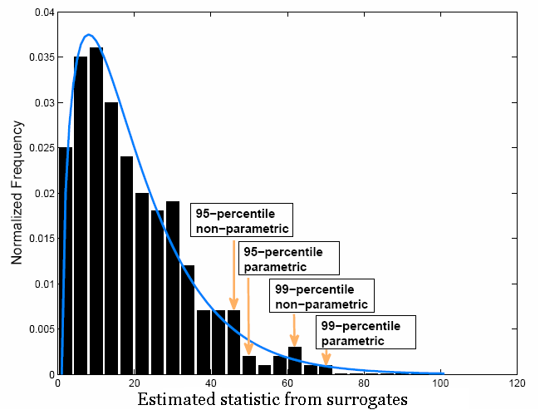
Surrogate / bootstrap methods
What does the shuffling do?
Preserves all statistics except autocorrelation
Same mean, variance, skew, kurtosis …
Non-parametric
technique
Does not assume
any distribution

Slide 12

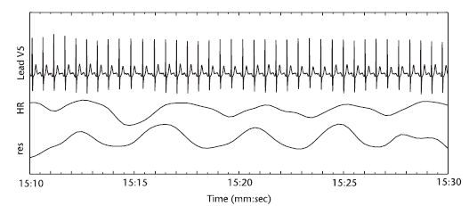
Recall – respiration from the ECG (EDR), HR (RSA) PPG, and IP:
Test significance between correlation
Notes:
From chapter 3 of my book

Slide 13
Correlation in frequency domain

Slide 14






Coherence analysis, or cross-spectral analysis, may be used to identify variations which have similar spectral properties (high power in the same spectral frequency bands)
Similar to FFT results with real and imaginary coefficients
The cross-spectrum is defined from the covariance function Cxy:
Complex function: the power is:
and the phase information is:
The coherence spectrum is analogous to the conventional correlation coefficient and is defined as:
Notes:
http://folk.uib.no/ngbnk/kurs/notes/node123.html
Von Storch and Zwiers (1999), p. 234-241
A cross-spectrum for two similar processes, but with one shifted in time with respect to the other: x(t) and x(t+τ), gives the same power spectrum as when the same analysis applied to two identical time series, x(t), but instead of a phase difference of zero, the phase is linear in frequency with a slope proportional to the phase shift phi_xy(w)=2pi tau w
In Matlab:
Cxy = mscohere(x,y) finds the magnitude squared coherence estimate Cxy of the input signals x and y using Welch's averaged, modified periodogram method. The magnitude squared coherence estimate is a function of frequency with values between 0 and 1 that indicates how well x corresponds to y at each frequency. The coherence is a function of the power spectral density (Pxx and Pyy)
of x and y and the cross power spectral density (Pxy) of x and y. x and y must be the same length. For real x and y, mscohere returns
a one-sided coherence estimate and for complex x or y, it returns a two-sided estimate.

Slide 15

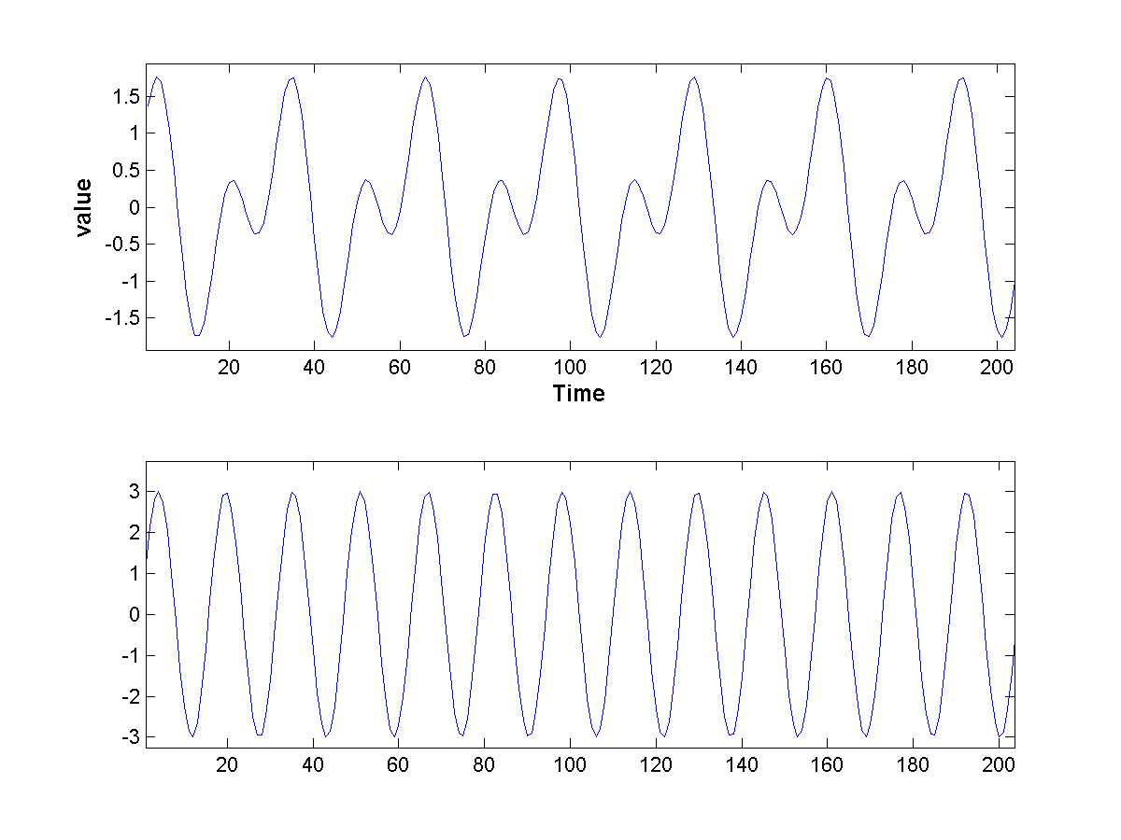
Two signals
One single freq
One dual freq
Share a common freq

Slide 16
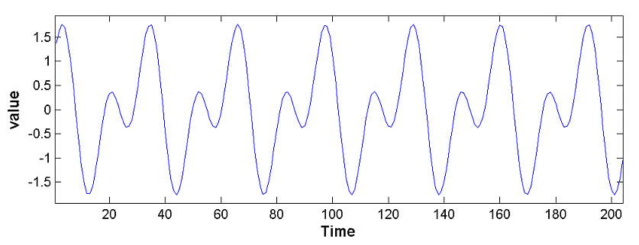
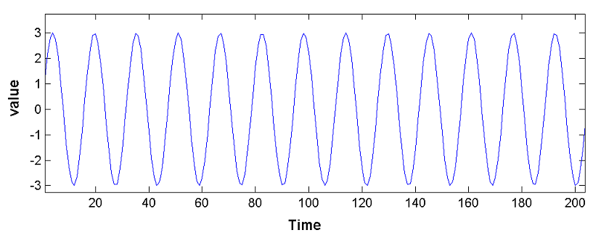
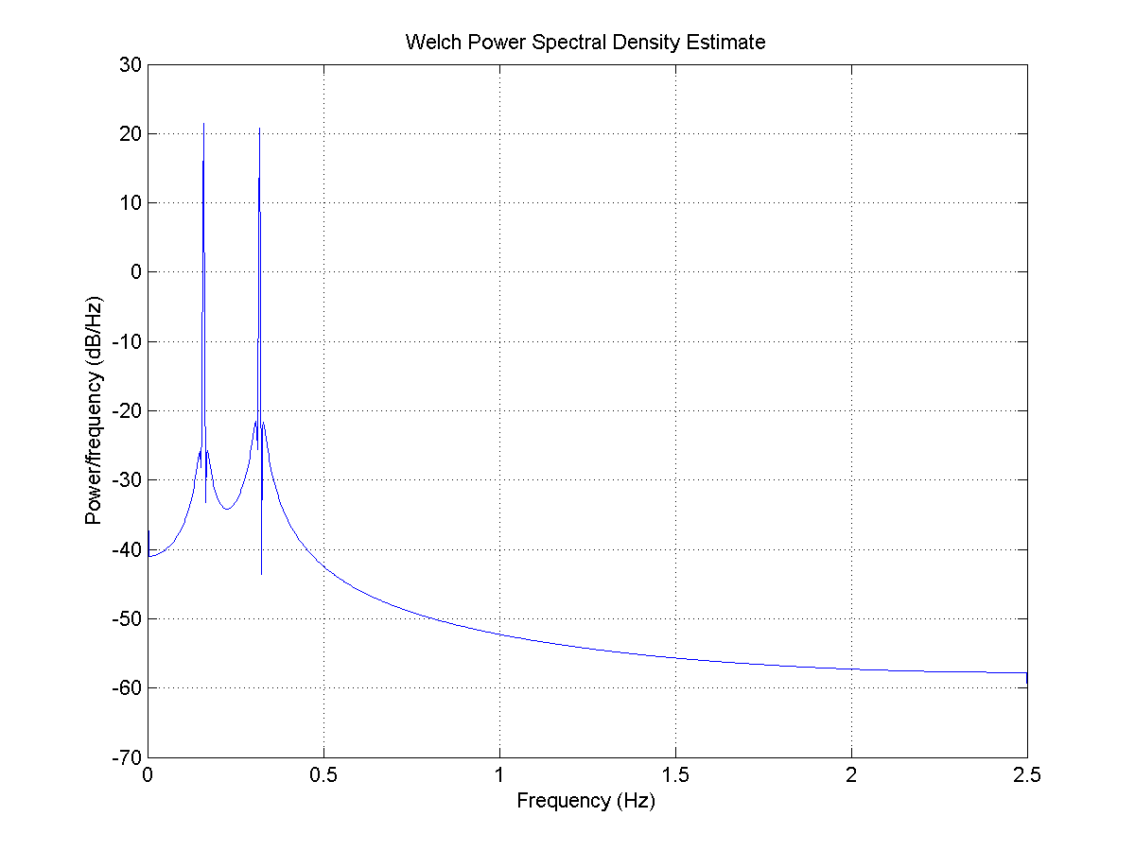
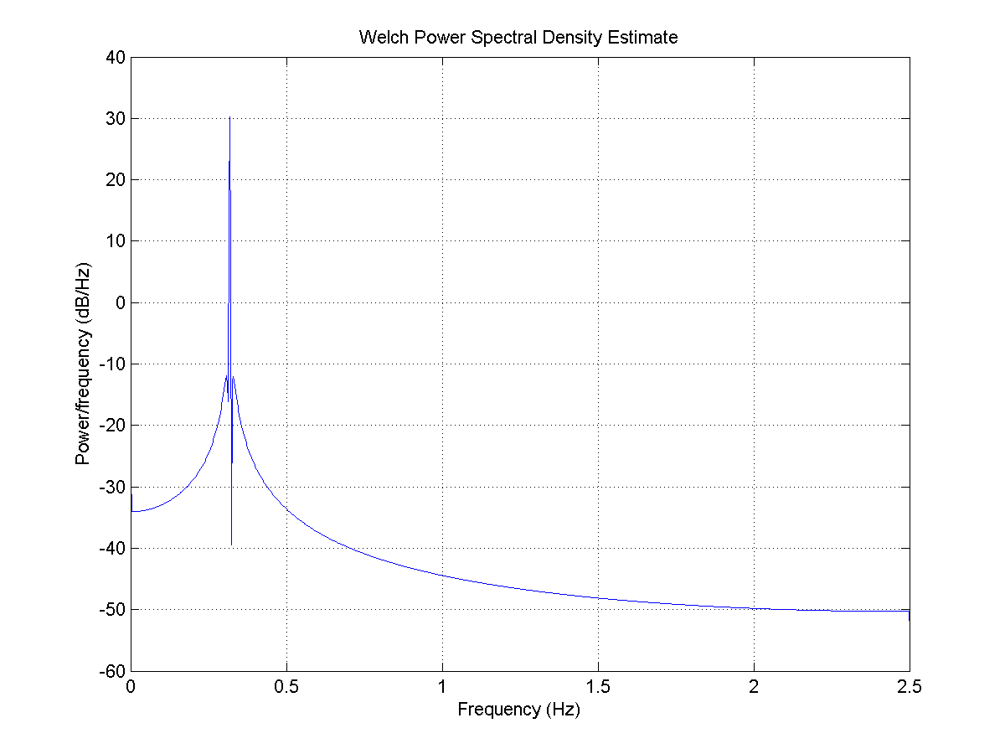

Slide 17

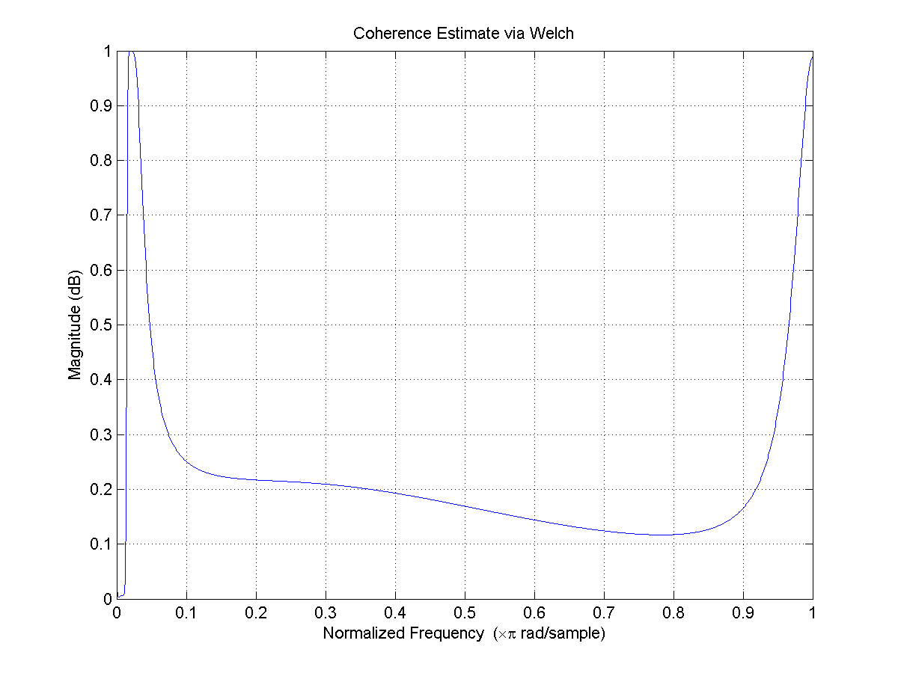
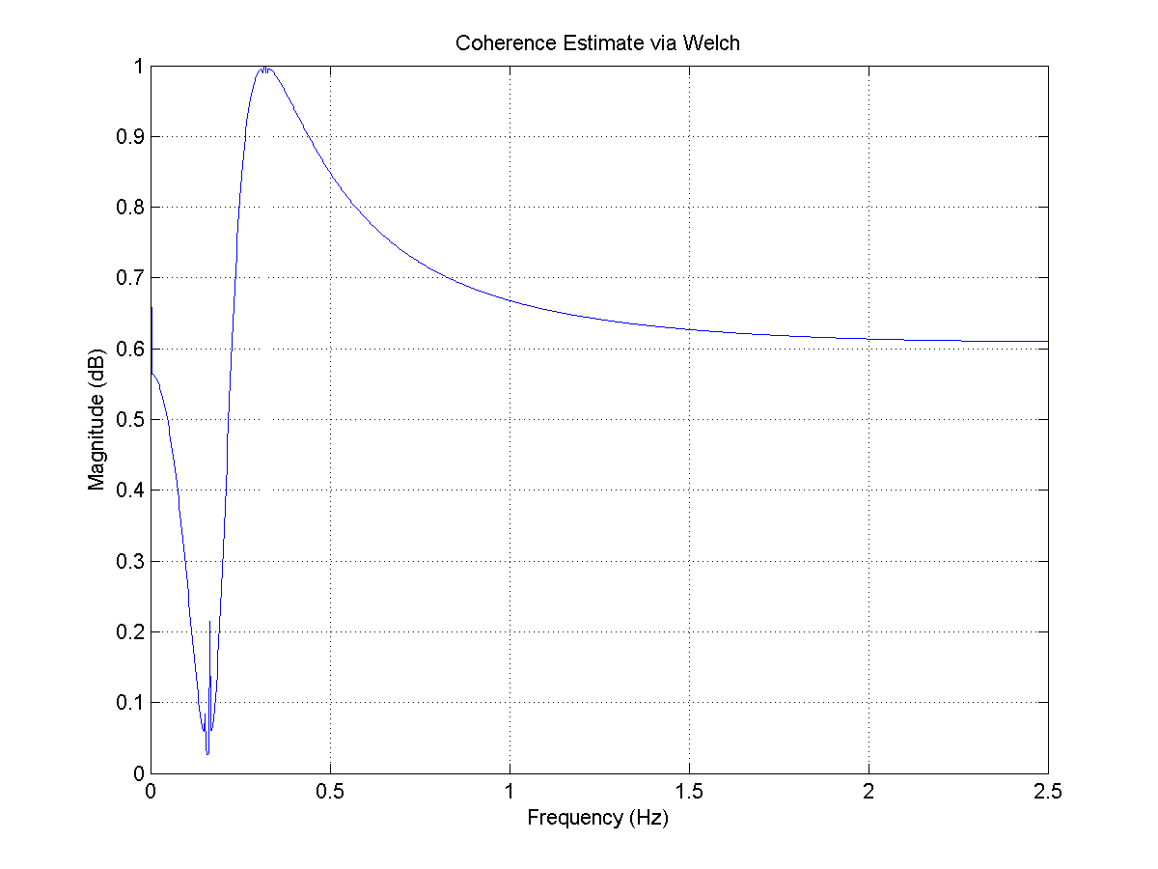
Coherence only at common frequency
Normalized
See:
  mschohere.m

Slide 18

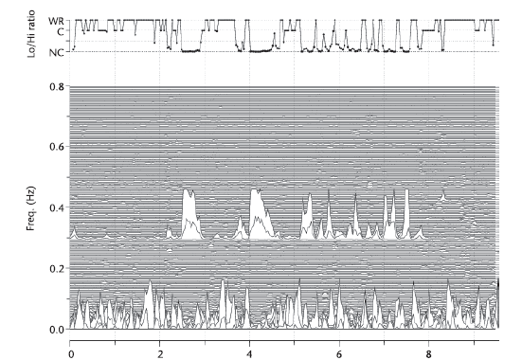
Example with EDR and RSA …
c.f. STFT

Slide 19

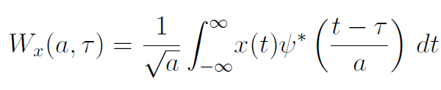
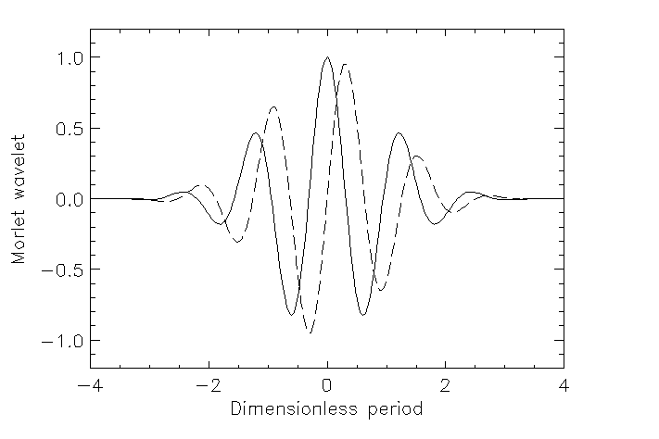

Non-stationary frequency coupling
W is the wavelet transform of x at scale a, and translation (time shift), τ.
Let’s consider the Morlet wavelet

Slide 20


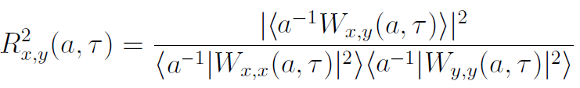
Wavelet Coherency
Cross wavelet transform of two time series x(t) and y(t) is given by:
Cross wavelet power:
  (common power in both time series)
Wavelet Coherency:
where <> represents a smoothing operator achieved by a convolution in time and scale:
Notes:
C1 and c2 are some normalization constants

Slide 21

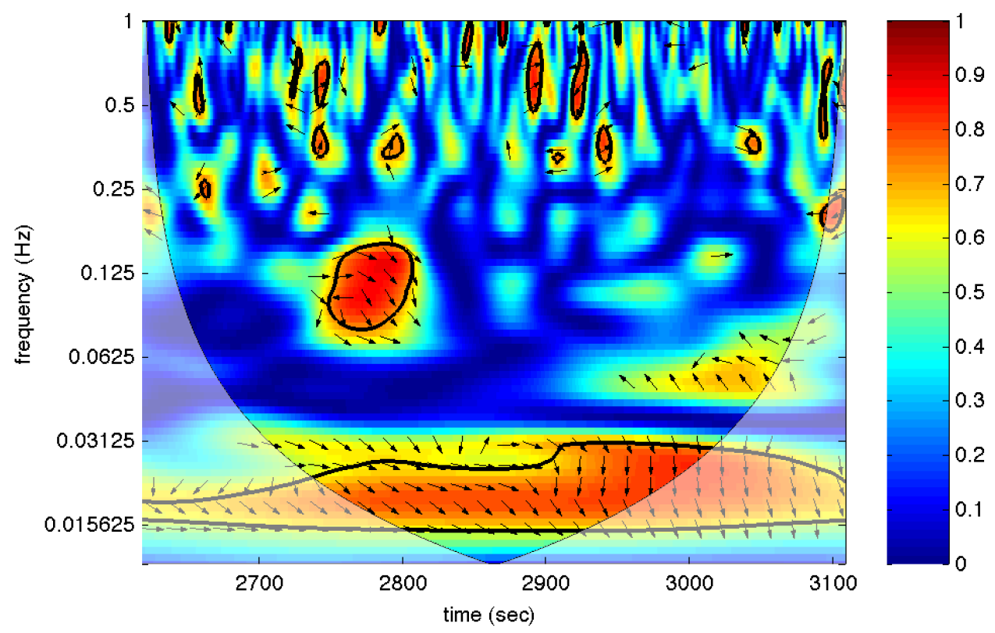

COI
Black arrows indicate the phase at a given time & frequency (point right for in-phase, left for anti-phase, down for X leading Y by 90 and up for Y leading X by 90)
Notes:
Blue indicates little to no coherence and red indicates strong coherence.
The black arrows indicate the phase at a given time frequency with phase arrows point right for in-phase, left for anti-phase, down for X leading Y by 90 and up for Y leading X by 90.
The 5% significance level against red noise is shown as a thick contour.

Slide 22
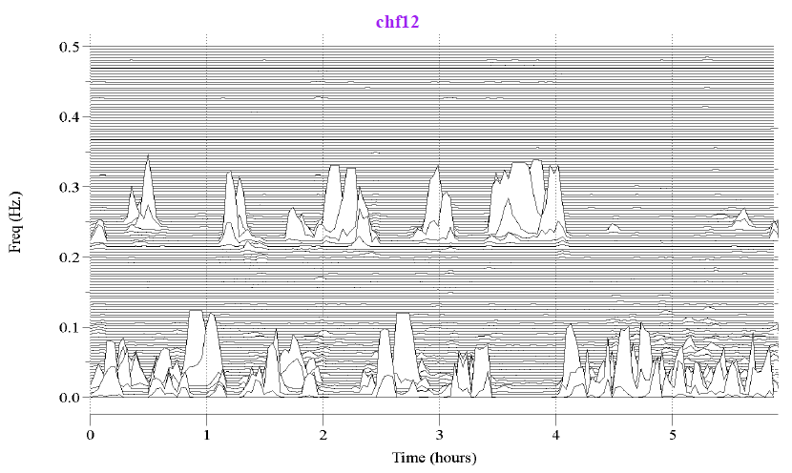
Comparison of mscohere and wtc

Slide 23
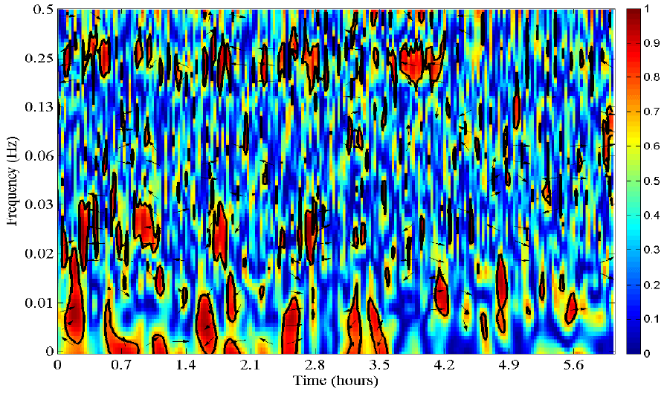
Comparison of mscohere and wtc

Slide 24
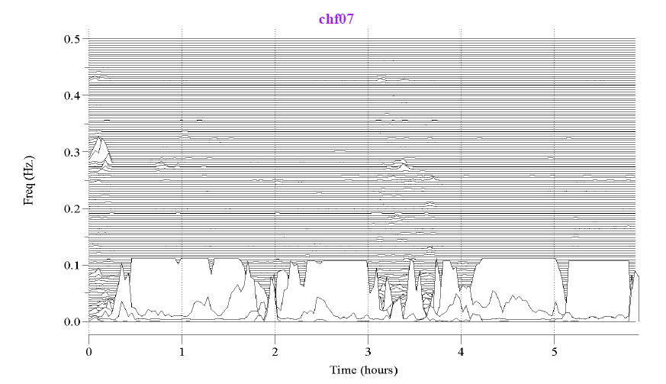
Comparison of mscohere and wtc

Slide 25
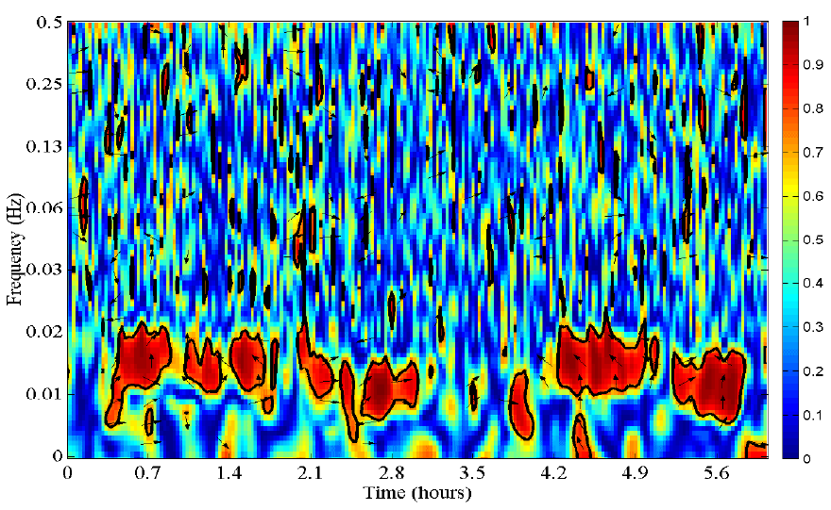
Comparison of mscohere and wtc

Slide 26

Are my peaks real?
Parametric tests
  False alarm probability when compared to the amplitude you would expect from a background noise (such as white noise)
Non-parametric tests
  Bootstrap or surrogate methods – phase randomisation

Slide 27
Parametric significance testing
If the PSD, P(ω), is normalized Scargle shows that the distribution of P(ω) is exponential
So the probability that P(ω) will be between some positive z and z + dz is exp(−z)dz
Therefore, if we scan some M independent frequencies, the probability that none give values larger than z is (1 − e^{-z})^{M}.
So P(> z) ≡ 1 − (1 − e^{-z})^{M} is the false alarm probability of the null hypothesis (that the data values are independent Gaussian random values)
i.e. the significance level of any peak in P(ω) that we do see. A small value for the false-alarm probability indicates a highly significant periodic signal.
Notes:
The word “normalized” refers to the factor σ2 in the denominator of equation (13.8.4).
Scargle [4] shows that with this normalization, at any particular ω and in the case of the null
hypothesis, PN(ω) has an exponential probability distribution with unit mean. In other words,
the probability that PN(ω) will be between some positive z and z + dz is exp(−z)dz. It
readily follows that, if we scan some M independent frequencies, the probability that none
give values larger than z is (1 − e
−z)M. So
P(> z) ≡ 1 − (1 − e
−z)M (13.8.7)
is the false-alarm probability of the null hypothesis, that is, the significance level of any peak
in PN(ω) that we do see. A small value for the false-alarm probability indicates a highly
significant periodic signal.
To evaluate this significance, we need to know M. After all, the more frequencies we
look at, the less significant is some one modest bump in the spectrum. (Look long enough,
find anything!) A typical procedure will be to plot PN(ω) as a function of many closely
spaced frequencies in some large frequency range. How many of these are independent?
Before answering, let us first see how accurately we need to know M. The interesting
region is where the significance is a small (significant) number, 1. There, equation (13.8.7)
can be series expanded to give
P(> z) ≈ Me−z
We see that the significance scales linearly with M. Practical significance levels are numbers
like 0.05, 0.01, 0.001, etc. An error of even +/- 50% in the estimated significance is often
tolerable, since quoted significance levels are typically spaced apart by factors of 5 or 10. So
our estimate of M need not be very accurate.
Horne and Baliunas [5] give results from extensive Monte Carlo experiments for determining
M in various cases. In general M depends on the number of frequencies sampled,
the number of data points N, and their detailed spacing. It turns out that M is very nearly
equal to N when the data points are approximately equally spaced, and when the sampled
frequencies “fill” (oversample) the frequency range from 0 to the Nyquist frequency fc
(equation 13.8.2). Further, the value of M is not importantly different for random spacing of
the data points than for equal spacing. When a larger frequency range than the Nyquist range
is sampled, M increases proportionally. About the only case where M differs significantly
from the case of evenly spaced points is when the points are closely clumped, say into
groups of 3; then (as one would expect) the number of independent frequencies is reduced
by a factor of about 3.

Slide 28
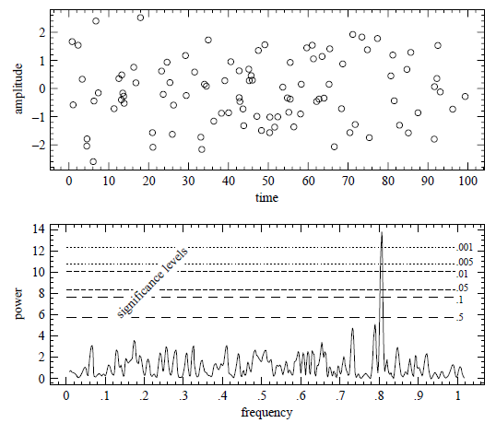
Parametric significance testing
A small value for the false-alarm probability indicates a highly significant periodic signal
Notes:
The word “normalized” refers to the factor σ2 in the denominator of equation (13.8.4).
Scargle [4] shows that with this normalization, at any particular ω and in the case of the null
hypothesis, PN(ω) has an exponential probability distribution with unit mean. In other words,
the probability that PN(ω) will be between some positive z and z + dz is exp(−z)dz. It
readily follows that, if we scan some M independent frequencies, the probability that none
give values larger than z is (1 − e
−z)M. So
P(> z) ≡ 1 − (1 − e
−z)M (13.8.7)
is the false-alarm probability of the null hypothesis, that is, the significance level of any peak
in PN(ω) that we do see. A small value for the false-alarm probability indicates a highly
significant periodic signal.
To evaluate this significance, we need to know M. After all, the more frequencies we
look at, the less significant is some one modest bump in the spectrum. (Look long enough,
find anything!) A typical procedure will be to plot PN(ω) as a function of many closely
spaced frequencies in some large frequency range. How many of these are independent?
Before answering, let us first see how accurately we need to know M. The interesting
region is where the significance is a small (significant) number, 1. There, equation (13.8.7)
can be series expanded to give
P(> z) ≈ Me−z
We see that the significance scales linearly with M. Practical significance levels are numbers
like 0.05, 0.01, 0.001, etc. An error of even +/- 50% in the estimated significance is often
tolerable, since quoted significance levels are typically spaced apart by factors of 5 or 10. So
our estimate of M need not be very accurate.
Horne and Baliunas [5] give results from extensive Monte Carlo experiments for determining
M in various cases. In general M depends on the number of frequencies sampled,
the number of data points N, and their detailed spacing. It turns out that M is very nearly
equal to N when the data points are approximately equally spaced, and when the sampled
frequencies “fill” (oversample) the frequency range from 0 to the Nyquist frequency fc
(equation 13.8.2). Further, the value of M is not importantly different for random spacing of
the data points than for equal spacing. When a larger frequency range than the Nyquist range
is sampled, M increases proportionally. About the only case where M differs significantly
from the case of evenly spaced points is when the points are closely clumped, say into
groups of 3; then (as one would expect) the number of independent frequencies is reduced
by a factor of about 3.

Slide 29
Nonparametric significance testing
Instead of shuffling time locations,
… shuffle phases in Fourier domain
Test cross spectral coherence of surrogates is > real coherence.
If larger over many bootstrap iterations, we have significance
Similar to time series bootstrap method
Notes:
Statistical signicance of cross-spectral coupling (wavelet coherence) was determined using Monte Carlo methods. The null hypothesis is taken as zero coherence between the data at a determined frequency. The data is modelled with a first order autoregressive process, generating a large ensemble of surrogate data set pairs. The wavelet coherence for each pair is calculated and, finally, the significance level is estimated for the different scale taking into account the values outside the COI

Slide 30
COI
Black arrows indicate the phase at a given time & frequency (point right for in-phase, left for anti-phase, down for X leading Y by 90 and up for Y leading X by 90)
Notes:
Blue indicates little to no coherence and red indicates strong coherence.
The black arrows indicate the phase at a given time frequency with phase arrows point right for in-phase, left for anti-phase, down for X leading Y by 90 and up for Y leading X by 90.
The 5% significance level against red noise is shown as a thick contour.

Slide 31
Read more …
The MatLab wavelet coherence package: wtc-r16.zip
Grinsted, A., S. Jevrejeva, J. Moore, "Application of the cross wavelet transform and wavelet coherence to geophysical time series." submitted to a special issue of Nonlinear Proc. Geophys., 'Nonlinear analysis of multivariate geoscientific data - advanced methods, theory and application', 2004 [pdf]
Torrence, C., and G.P. Compo, A practical guide to wavelet analysis, Bull. Am. Meteorol. Soc., 79, 61-78, 1998.
http://www.pol.ac.uk/home/research/waveletcoherence/download.html

Slide 32
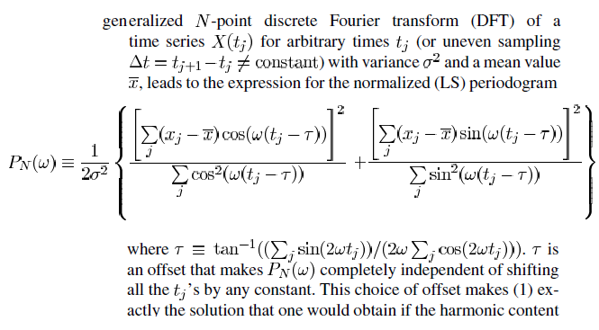
The Lomb-Scargle Periodogram
Spectral estimation of unevenly sampled data without resampling
Variable integration step size
Equivalent to least squares fitting of sines to data!

